Slide 1
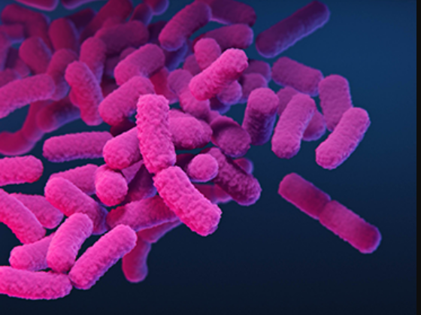
Enterobacteriaceae
prof.Dr. Lamyaa kadhim
Medical Microbiology
(Part 1+Part 2)

Slide 2
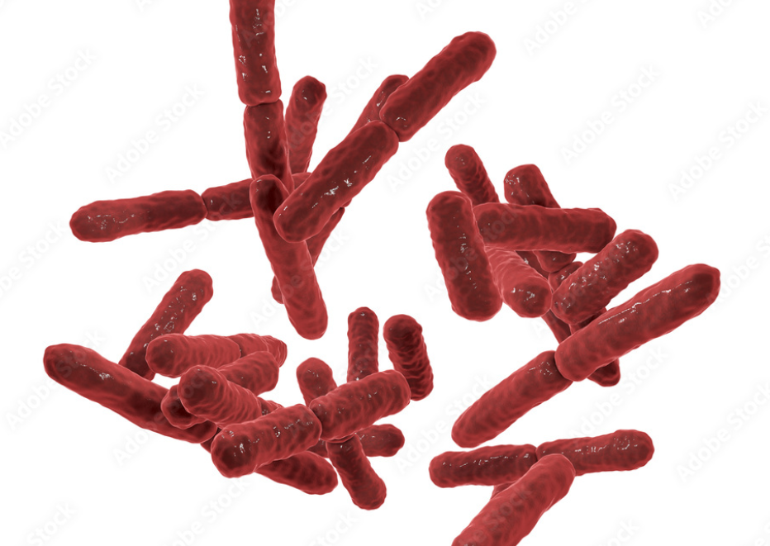
Learning objectives
Describe general characters of the family Enterobacteriaceae
Classify the family Enterobacteriaceae
Describe morphology ,culture characteristics and biochemical reactions of this family
Discuss pathogenicity of E.coli
Discuss various groups of E.coli producing diarrhea
Describe other genera related of the family Enterobacteriaceae

Slide 3
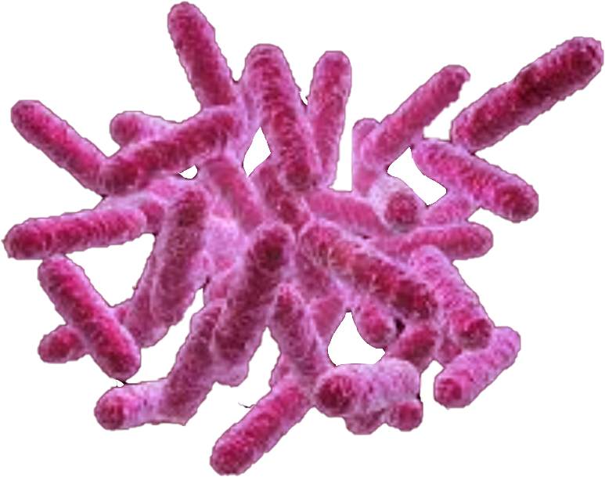
Enterobacteriaceae (Enteric Bacilli or Enterics)
A large family of aerobic Gram negative bacterial rods that inhabit the normal gut of humans and other animals (normal flora) and sometimes cause disease.
In humans ,they are found at
a density of approximately 10⁹ cells
per gram of stool.

Slide 4
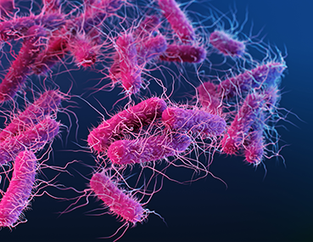
General features of Enterobacteriaceae
- Rapidly growing cells 2 µm x 0.4 µm in size.
- All members are non-spore forming , gram negative bacilli.
- Capsule ±
- Motility ±
- Grow readily on ordinary media
Ferment glucose
Reduce nitrates to nitrites
All are oxidase- negative
Form catalase
All species are endotoxigenic because of the lipopolysaccharide outer cell wall

Slide 5
All Enterobacteriaceae are potentially pathogenic. Patients who are immunosuppressed ,undergoing mechanical or medical manipulation or have underlying disease are most susceptible to infection.
Enterobacteriaceae commonly causing human disease ( based on Taxonomic classification)
Genus Representative species
Escherichia E.coli (5)
Shigella S.dysenteriae
Salmonella S.typhi
S .paratyphi
S.typhimurium
Klebsiella K.pneumonia
Proteus P.mirabilis
Yersinia Y.pestis(11)
Enterobacter E.cloacae

Slide 7
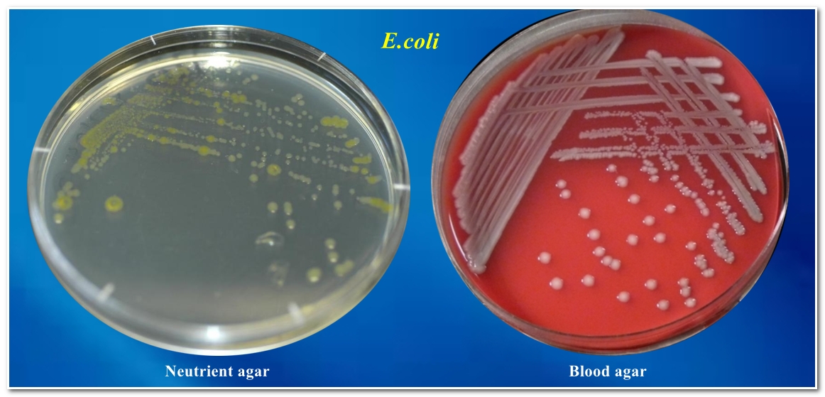
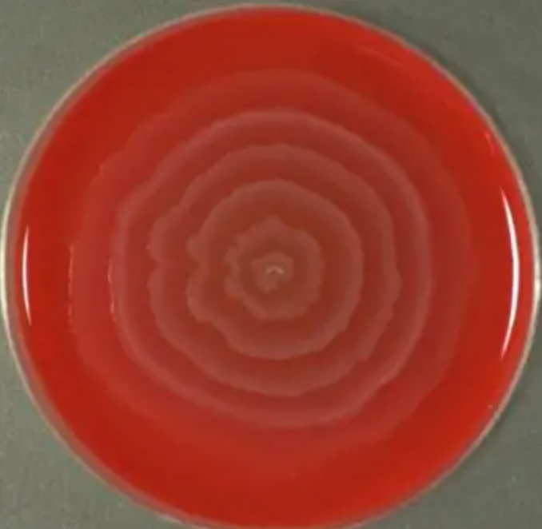
Culture and identification
Enterobacteriaceae grow well on ordinary media (e.g. blood agar, nutrient agar).
They produce characteristic circular, convex and glistening / mucoid colonies.
Some motile species form swarming pattern on agar culture

Slide 8
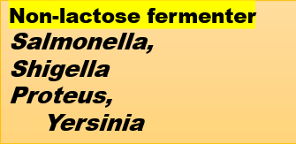
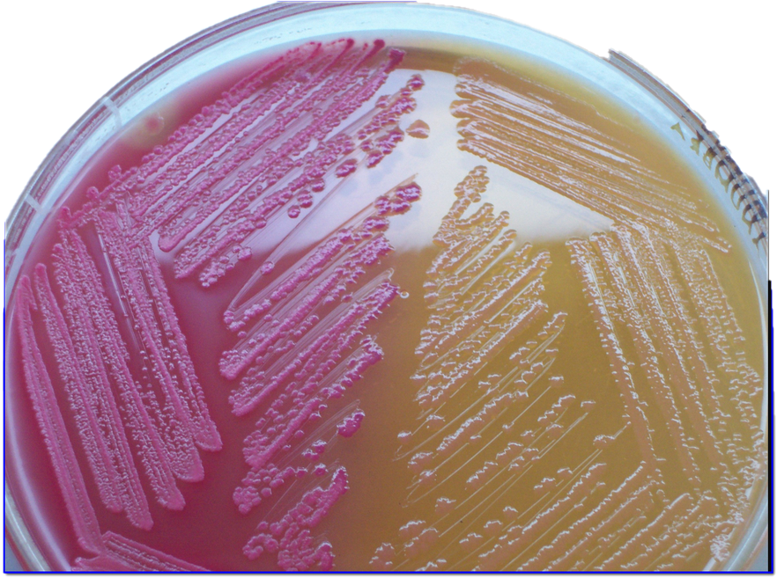
Using a selective medium such as MacConkey‘s agar , Enterobacteriaceae are initially classified into
Classification of enterobacteriaceae
Lactose fermenter E.coli,
Klebsiella,
Citrobacter
,Enterobacter
Enterobacteriaceae ferment
a large number of carbohydrates.

Slide 9
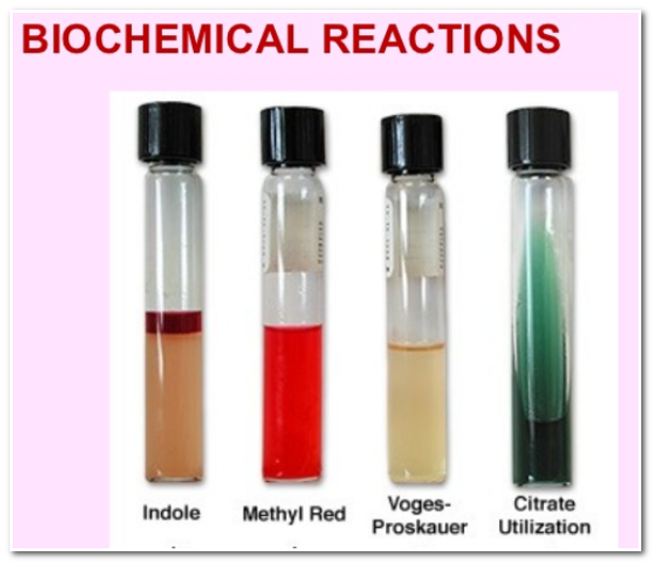
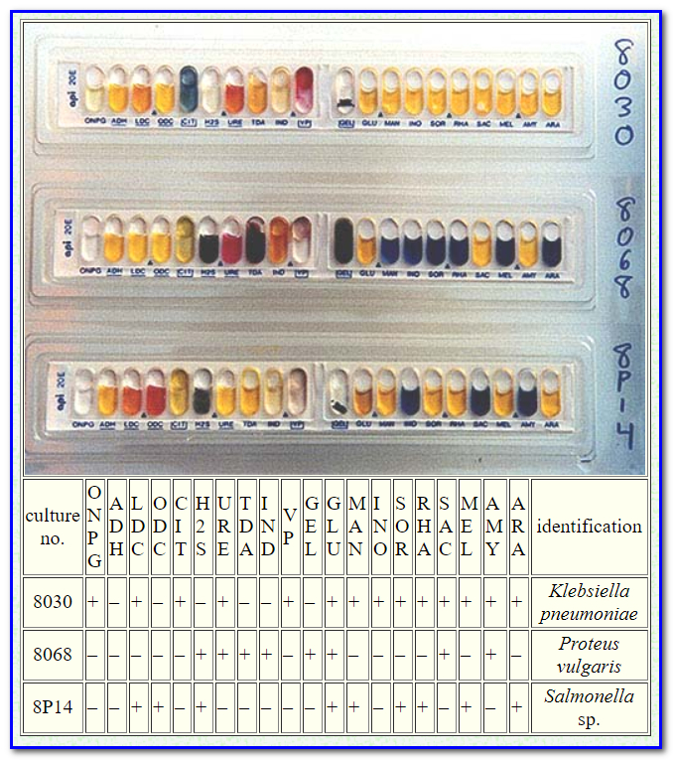
Biochemical tests
Due to wide biochemical heterogeneity ,several biochemical tests are used to identify species of Enterobacteriaceae. This can be performed manually or using commercially available kit systems.

Slide 10
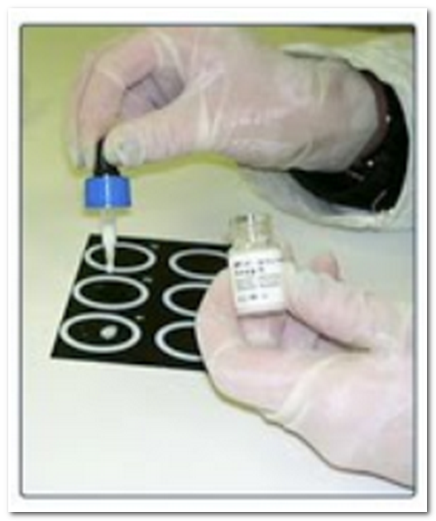
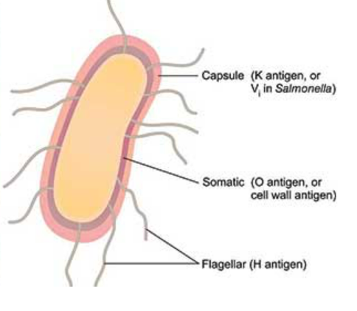
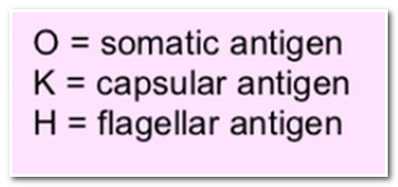
Serological tests
These are based on the antigens of the organisms.
-All species have the somatic (O) antigen
-Most have the flagellar (H) antigen
-Some species have the capsular (K) antigen

Slide 11
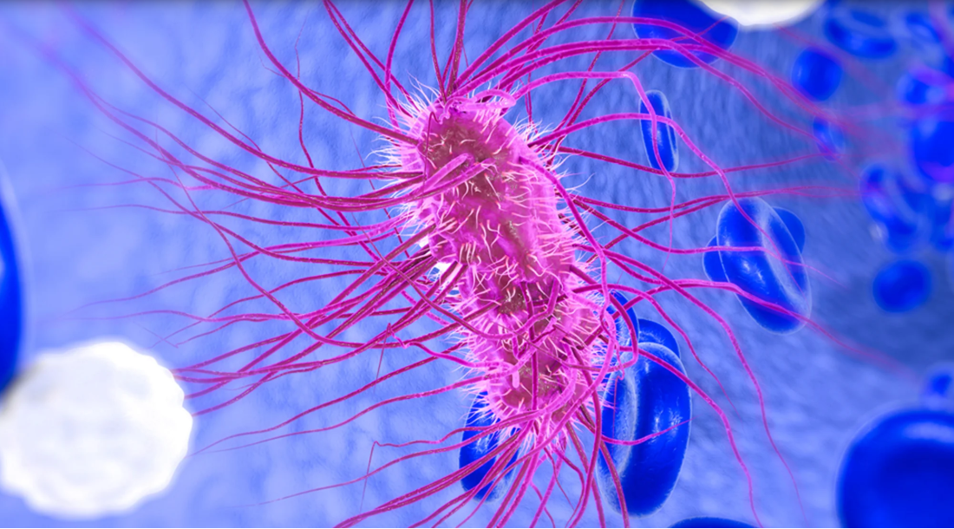
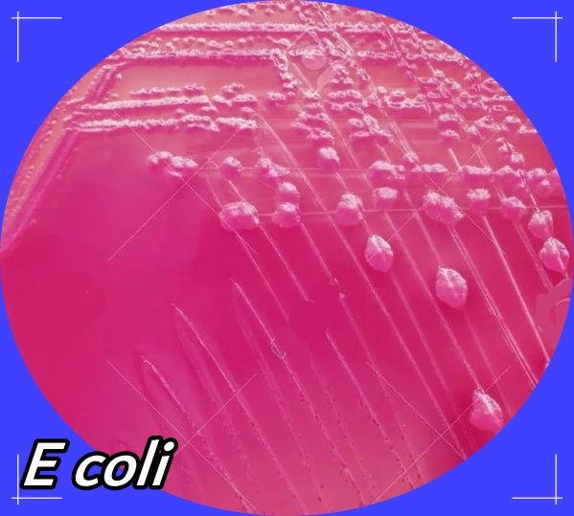
Escherichia coli {E.coli}
One of the most important pathogen in the Enterobacteriaceae family.
- It is indigenous commensal of human intestinal tract
- It is gram –negative bacteria, motile, facultative aerobe
- Grows well on blood agar
- Ferments lactose (pink colonies on MacConkey´s agar)
- Commercial kits are used in identification

Slide 12
Pathogenicity of E.coli
Escherichia coli are major agents of sepsis; Transmission is either endogenous or exogenous.
It causes the following diseases :
1-Urinary tract infection
E. coli is the leading cause of urinary tract infection. Young women and elderly adults are most susceptible. The disease varies from simple urethritis to serious pyelonephritis
2- Gastroenteritis (Diarrheal diseases )
These range from simple diarrhea to severe disease leading to excessive fluid loss and dehydration, which can be fatal in malnourished infants and elderly debilitated adults.
3-Neonatal meningitis and septicemia
4-Wound infection
particularly after surgery of lower intestinal tract.

Slide 13
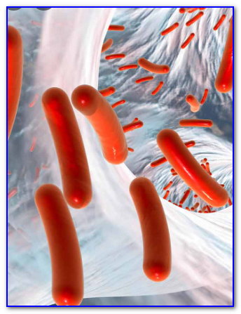
E. coli Gastroenteritis
Many strains of E. coli have powerful toxins and other mechanisms by which they cause diarrhea. These mechanisms include::
1-Production of Enterotoxins : mainly two types, one is heat-labile (LT) and is similar in action to cholera toxin, and the other is heat-stable (ST)
2-Enteroinvasiveness : some strains have the ability to invade
intestinal epithelial cells and cause inflammation
3-Adhesive factors : are produced by some strains enabling adhesion
to intestinal mucosa
4-Vero cytotoxicity : some strains produce toxins with profound and irreversible effect on Vero cells (grown in tissue culture) .These strains can cause hemorrhagic diarrhea. They are also called Shiga toxin producing E. coli since the toxin is similar to that produced by Shigella dysenteriae type 1

Slide 14
Classification of diarrhea-producing E.coli
Based on the mechanisms of actions :
1-Enterotoxigenic Escherichia coli (ETEC)
2-Enterohemorrhagic Escherichia coli (EHEC)
3-Enteropathogenic Escherichia coli (EPEC)
4-Enteroinvasive Escherichia coli (EIEC)

Slide 15
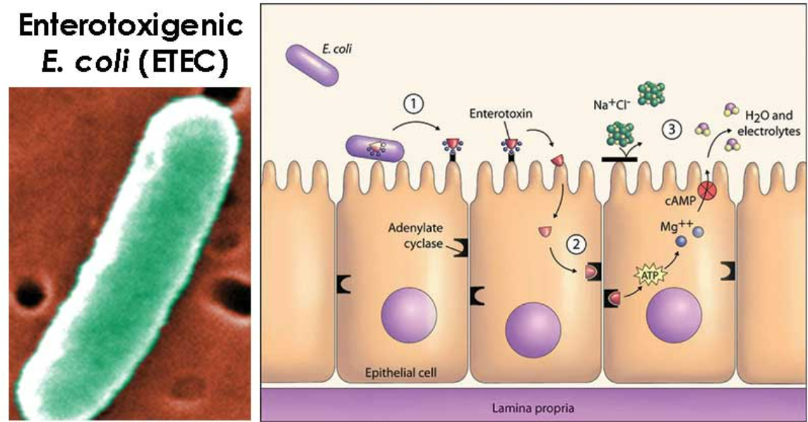
Enterotoxigenic Escherichia coli (ETEC)
Transmission : ingestion of contaminated food or water
Disease : Common cause of Traveler´s Diarrhea
Pathogenesis : secretion of two different toxins,
heat-labile and heat stable enterotoxins. The bacteria adhere to intestinal epithelial cells but do not invade.
Clinical manifestation : watery diarrhea

Slide 16
Enterohemorrhagic Escherichia coli (EHEC)
Transmission : ingestion of contaminated food or water.
Outbreaks have occurred from undercooked hamburgers ,and contaminated water in swimming pools.
Disease : Hemorrhagic Colitis
Pathogenesis : EHEC adhere to colonic epithelial cells and secrete Shiga-like toxin that is absorbed by the host cells and results in cell death in the host.
Clinical manifestation : hemorrhagic diarrhea
and can progress to hemolytic uremic syndrome
when the bacterial toxin enters the circulation
and causes abnormal destruction of red blood cells.
The destructed RBCs accumulate in the filtering system
of kidneys leading to acute renal failure.

Slide 17
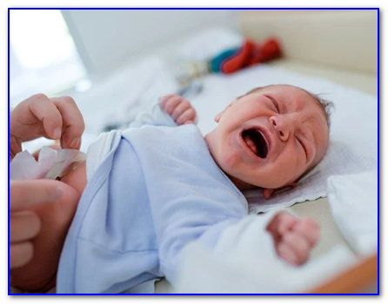
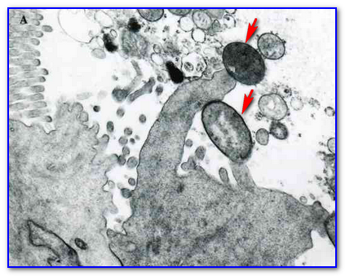
Enteropathogenic Escherichia coli (EPEC)
Disease : Infant diarrhea , especially in underdeveloped countries
Pathogenesis : EPEC attachment to epithelial cells of
the small intestine stimulates a host cell reactions resulting in destruction of microvilli, and decreased fluid absorption causing persistent watery diarrhea.
Clinical manifestation : watery diarrhea often accompanied by vomiting

Slide 18
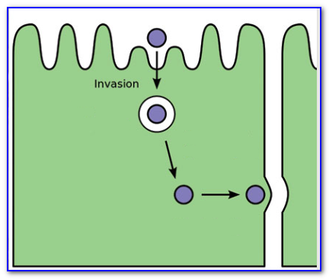
Enteroinvasive Escherichia coli (EIEC)
Transmission: EIEC outbreaks are usually foodborne or waterborne
Disease : Bacillary Dysentery resembles shigellosis
Pathogenesis : EIEC attaches and invades colonic epithelial cells,resulting in cell death and inflammation. Disease process very similar to that of Shigella.
Clinical manifestation :Dysentery ; mild or severe abdominal
cramps and severe diarrhea with mucus or blood in the feces.

Slide 19
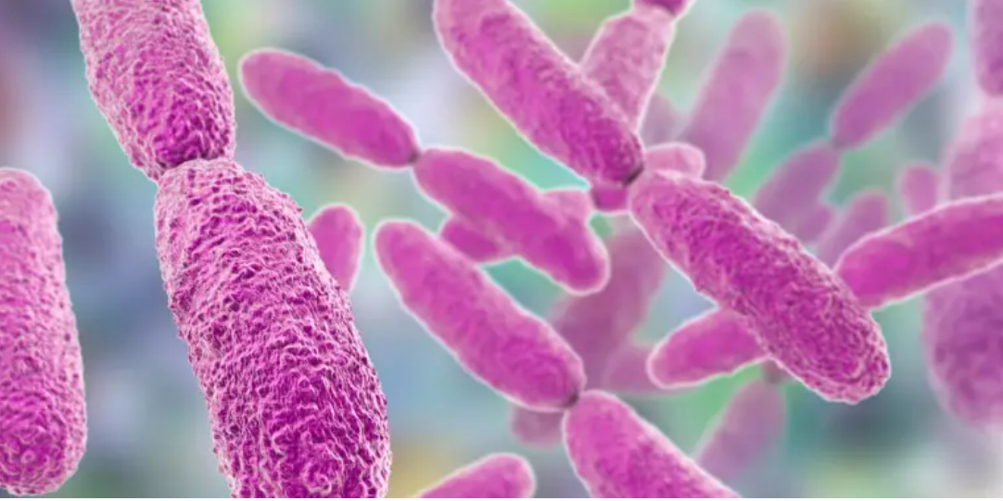
Other Enterobacteriaceae

Slide 20
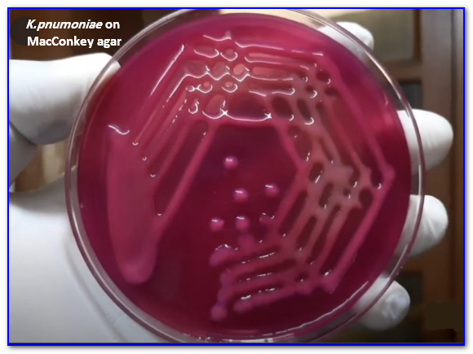
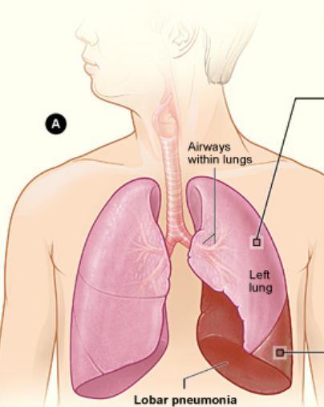
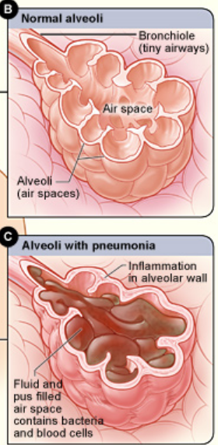
Klebsiella
-Members of the genus Klebsiella have a prominent capsule that is responsible for the mucoid appearance of isolated colonies and the enhanced virulence of the organisms.
-The most commonly isolated members of this genus are Klebsiella pneumoniae and K.oxytoca.
Diseases caused by Klebsiella:
- Community – or hospital acquired lobar pneumonia
- Wound and soft tissue infections
- UTIs

Slide 21
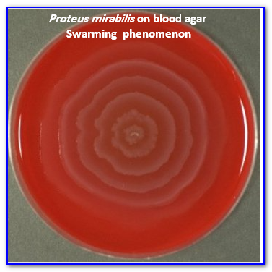
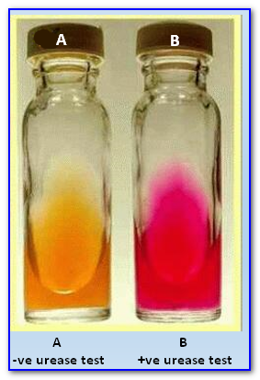
Proteus
-P. mirabilis, P. vulgaris are the most common members of this genus, primarily
produces infections of the urinary tract (e.g., bladder infection (cystitis);
kidney infection or pyelonephritis).
- Both produce swarming colonies on non-selective media
-P. mirabilis is strong urease positive (produces large quantities of
urease, which splits urea into carbon dioxide and ammonia.
This process raises the urine pH, precipitating magnesium and
calcium into crystals, which results in the formation of renal stones.
-The increased alkalinity of the urine is also toxic to the uroepithelium

Slide 22
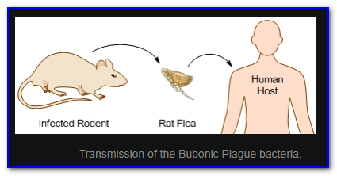
Yersinia
-The best known human pathogens within the genus Yersinia are:
Y. pestis, Yersinia enterocolitica, and Yersinia pseudotuberculosis.
-Y. pestis is a highly virulent pathogen that causes the highly fatal systemic disease known as plague . Epidemics of the plague were recorded in the old history.
Y. enterocolitica and Y. pseudotuberculosis are primarily enteric pathogens that are relatively uncommon
-All Yersinia infections are zoonotic, with humans the accidental hosts.

Slide 23
Enterobacter, Citrobacter, Morganella, and Serratia
- Primary infections caused by Enterobacter, Citrobacter, Morganella, and Serratia are rare in healthy individuals.
-They are more common causes of hospital-acquired infections in neonates and immunocompromised patients.
Citrobacter koseri for example, has been recognized to have a predilection for causing meningitis and brain abscesses in neonates

Slide 24
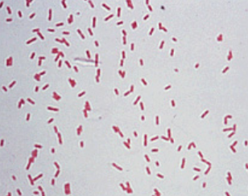
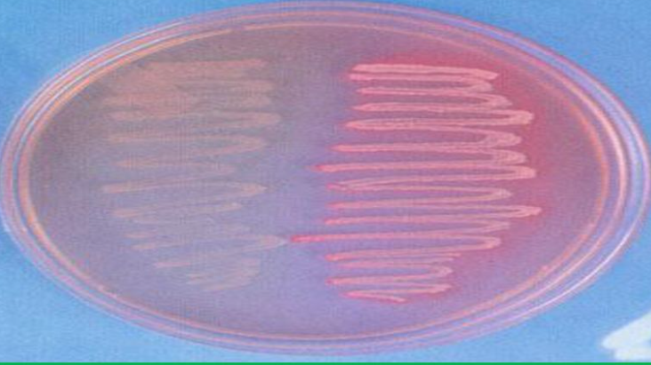
Pseudomonas aeruginosa
These bacteria are gram negative rods not belonging to
the family Entrobacteriaceae.
There are many species of Pseudomonas but Pseudomonas aeruginosa, specifically, is non lactose fermenter.
It is opportunistic pathogen and it is the most significant cause of hospital acquired infections. The spectrum of clinical disease ranges from UTIs to septicemia, pneumonia , meningitis, and infections of postsurgical and posttraumatic wounds.
P. aeruginosa multidrug-resistant bacteria.
Non- Lactose fermenter

Slide 25
